Slide 1
NPA and Xponent Overview
Database overview with Applications
Yulei Zhao

Slide 2
content
Drug Flow Chart & IMS Data base
IMS Prescription data
NPA & Xponent
What’s the data base
Comparison
How to request the data
Appendix: Xponent projection methodology & Prescription Database

Slide 3
Drug Flow Chart
Doctor Public
LRX
Xponent family
Drugs Update
Pharmacies
Media & M.Rs
Internet
Seminars
Medical Mag.
IMS Health
Market
Study
Product Sale(DDD)
Super Market
Wholesaler
Promote
Manufacturers
All
Drugs
NPA/NSP
Notes:
LIP delivers:
the CPI file
Global PIN delivers:
the local corporation file
DDMS delivers:
the Geography / ward information
the Hospital Hiding file
COBRA delivers:
the transaction file
Medicare delivers:
the client factor file,
the Projection factors
the backdata price changes
the superproduct links, etc

Slide 4
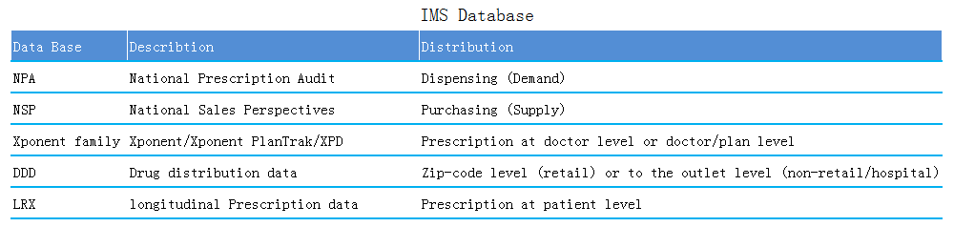
IMS Database

Slide 5
IMS Prescription Database
The IMS US prescription database is a representative sample of retail (Chains, Food stores w/ Pharmacies, Mass Merchants/Discount Houses and Independents), mail service and long-term care facilities
IMS Captures:
~200 million prescriptions collected per month and include:
185 million retail prescriptions in the U.S. and Puerto Rico (1.8 million p/month)
14 million monthly mail service prescriptions
14-15 million monthly long-term care prescriptions
Continued focus on ‘specialty’ product mail service pharmacies
*Coverage based on 12 months ending November 2009

Slide 6
IMS Prescription Services: Prescription Coverage by State
By State:
12 states & DC > 80%
19 states >70%<80%
13 states >60%>70%
4 states >50%<60%
2 states ~46%
Puerto Rico ~ 72%
Military (like AE,AP,AS,GU,
MP,UN,VI,etc. update)
*Coverage based on 12 months ending November 2009
•
6

Slide 7
IMS Prescription Database Summary channel key: 1 retail 2 mail order 3 LTC
Retail
80% coverage including Alternative data Sources
Approximately 2.5 Billion transactions US annually
Mail
60 to 80% incl CTS specialty
Approximately 150 million transactions annually
LTC
50 to 60%
Over 170 million transactions annually
Projected to a known universe
100% territory of origin
96% matched to Prescriber
3.5 % matched to Prescriber Zip
.5 % matched to Store Zip
Non projected sub-nationally
100% matched to territory of origin
Projected to a known universe
100% matched to the territory of origin
long-term care channel
Mail order

Slide 8
What is the National Prescription Audit?
NPA tracks the outflow of prescriptions through the “front door” of an outlet into the marketplace
US national level
IMS collects every New and Refill RX from pharmacies in our sample
Data is projected to the universe
Pharmacy
Patients
Notes:
The First Audit I’d like to present is our National Prescription Audit or as it is referred – NPA
NPA Tracks the outflow of Scripts into the hands of the consumer
It presents National Level information, and shows Market Demand

Slide 9
What Is NPA?
Available daily, weekly and monthly
A reflection of both what is written by the prescriber and what is dispensed by the pharmacist
Includes Retail, Mail Service and Long-Term Care channels
Notes:
This Audit is available Weekly and Monthly
It presents what is written by the Doctor, and what is dispensed by the pharmacist; therefore, NPA reflects substitution data.
The channels covered in NPA are: Retail, Mail Service and Long Term Care
Weekly data does not reflect LTC

Slide 10
What is Xponent?
Xponent represents what is prescribed by physicians and dispensed to patients by pharmacies
Xponent provides:
Monthly/weekly prescriber-level data
Doctor profile
Aggregated and ranked
For each doctor, market and product combination
Xponent also includes:
A “Best in Class” offering for Specialty markets
An integrated view of Patient-Centric insights
An ‘Early View’ of weekly uptake
Custom applications through Consulting

Slide 11
Example for NPA/Xponent data
One example

Slide 12
NPA and Xponent Retail Retail Data Will Match at a National Level
Xponent US = NPA
Notes:
In dataview, NPA=Xponent US Only

Slide 13
Xponent Mail Service
Xponent Mail Service = NPA Mail Service
Mail Service can be projected in Xponent
IMS recommends unprojected Mail Service at the subnational level

Slide 14
Xponent data compared with NPA
Xponent
NPA
Comparable. We should select scripts in US only:
geography=US
or outlet state=50 states+DC
Comparable. just US
Retail
Not comparable. Unprojected.
Not comparable. Projected.
Mail Order
Long term Care
?
?
Note: It is just for comparison with NPA when we Select US based on outlet state. If the client wants to get US market analysis, it is based on prescriber state=US(50states+DC)

Slide 15
How to request NPA and Xponent data
NPA:
Dataview
Smart(https://customerportal.imshealth.com apply)
Xponent:
Create system (http://plysapp53d:8092/portal/login.do)

Slide 16
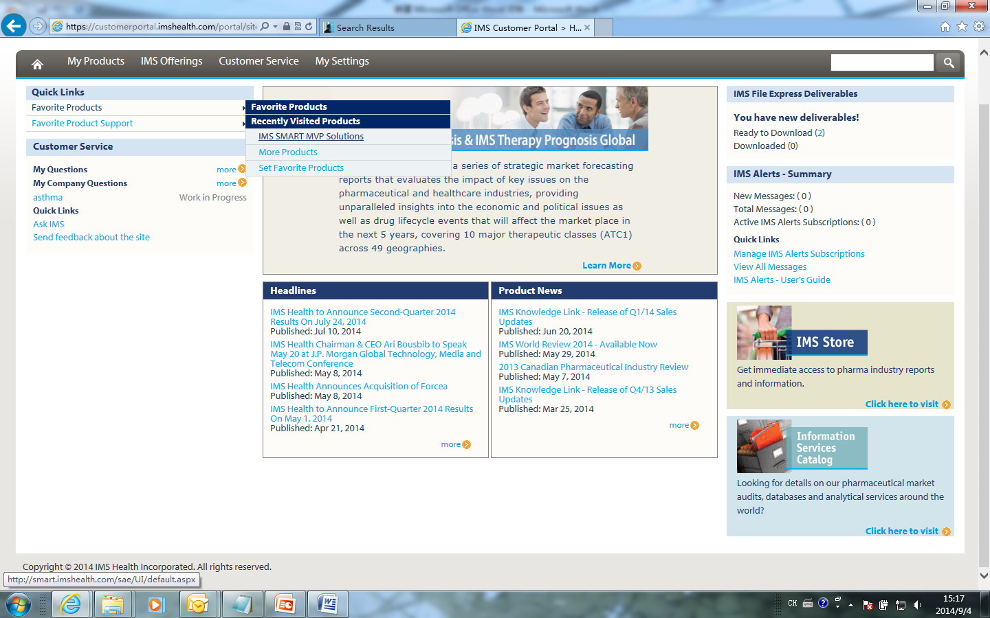
Details to request NPA Step1 click Favorite Products-IMS SMART MVP Solutions

Slide 17
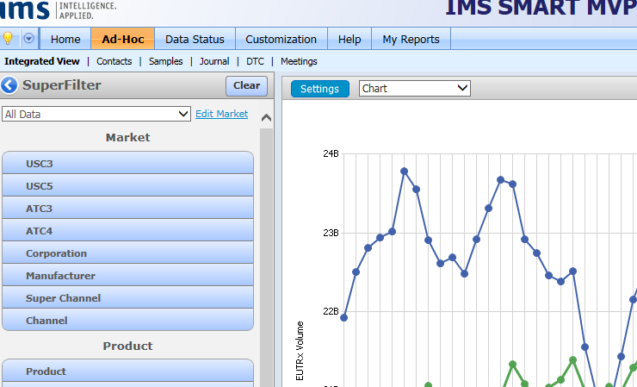
Step2-click Ad-Hoc at the top left corner

Slide 18
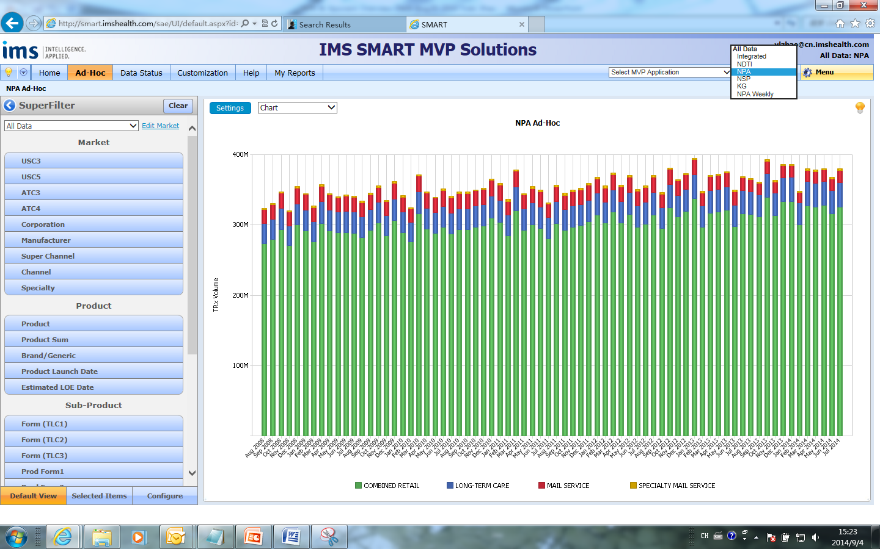
Step3-click NPA or other dataset

Slide 19
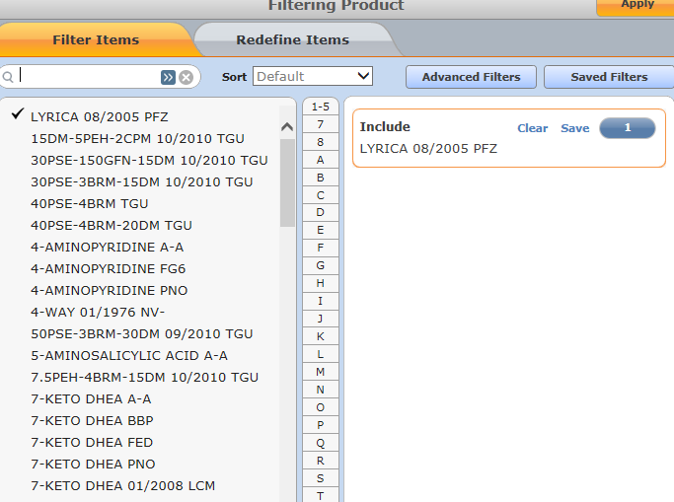
Step4-select market/product/sub-product/month information

Slide 20
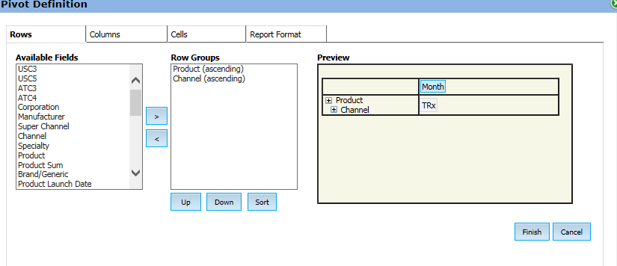
Step5-click setting to define pivot

Slide 21
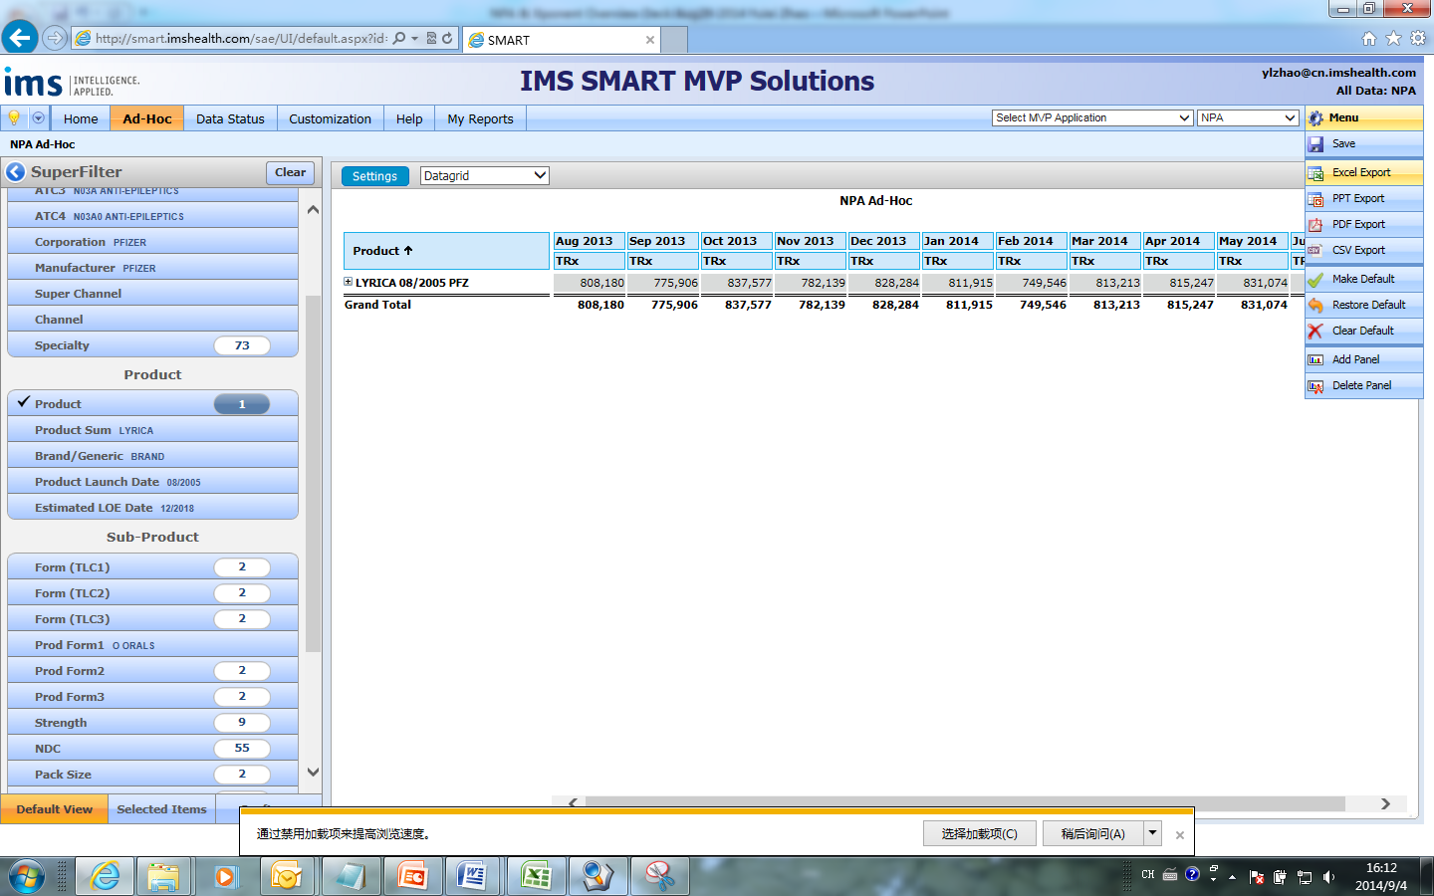
Step6-click menu to export

Slide 22
Appendix: Xponent data projection

Slide 23
Principles Used in Estimation
Ratio Estimation
Determine size of products within non-sample outlets
Ratio = # Rxs for Drug in Sample Pharmacy
$ for Drug Sold to Sample Pharmacy
Apply ratio to amount of drug sold to non-sample pharmacies
Geospatial Statistics
Closer points have similar values
Patent

Slide 24
Estimation
Ratio estimation to estimate product size.
Identify what you know.
Create projection factors based on:
Distance between sample and non-sample store
Sell-in for each product (DDD)
Estimate prescriptions for non-sample pharmacies.
Add the totals.

Slide 25
Conceptual Illustration
Geospatial Statistics
Closer points have more similar values

Slide 26
Conceptual Calculation
Step 2
Steps 1, 3
Step 4
Dr. Black’s Prescription for P/F/S | Store Weight | Weighted Prescriptions
4 | 0.35 | 1.4
8 | 0.30 | 2.4
2 | 0.25 | 0.5
6 | 0.15 | 0.9
0 | 0.07 | 0.0
Total |  | 5.2*
Step 5
The estimate of Dr. Black’s prescriptions for this P/F/S (product/form/strength) at this non-sample store is 5.2. Note that the weights will not necessarily sum to 1.0 to the DDD dollar volume sizing.

Slide 27
Prescription Services Estimation Methodology
Projection factors based on:
Distance sample to non-sample stores
Product-specific sell-in data (DDD)
Measurement of store size

One projection factor for each product per outlet

Over 160 million projection factors created each week

Slide 28
Appendix: Prescription Database

Slide 29
Prescription Database
NPA | Xponent | Xponent PlanTrak | PlanTrak | XPD (Updated) | RX BD
Strategic Applications Prescription characteristics New product launches Substitution activity Dosage information Forecasting | Tactical Applications Targeting Profiling Compensation Competitive Analysis | Tactical Applications Sharpen targeting Track formulary compliance Measure pull- through promotions | Tactical Applications Determine plan contracts Target plans and evaluate promotions Quantify control over prescribing | Strategic Applications Prescription characteristics New product launches Substitution activity Dosage information Forecasting Segmentation | Track formulary Setup health insurance plan’s co-pay structure
Six-year history file | Two-year history file | Two-year history file | Two-year history file | Two-year history file | Two-year history file
Used by Market Researchers and the financial community | Used by Sales Administration | Used by Sales Administration | Used by Marketing and NAMs | Used by Market Researchers and the financial community | Used by Market Researchers and the financial community
Projected | Projected | Projected | Projected | Projected | Projected
National | Subnational | Sub-plan | Plan | Subnational | Subnational

Slide 30
Xponent PlanTrak vs. Xponent
 | Xponent PlanTrak | Xponent
Data Level | ‘Plan within prescriber’ or ‘prescriber within plan’ and up to plan and national levels | Prescriber level and up to national level
Measure | Measures plan and prescriber/ plan activity | Measures prescriber activity
Projection Methodology | One Prescription Services Estimation Methodology
Payment | Cash, Medicaid, third-party, and specific plan breakout for Retail and Long-Term Care | Cash, Medicaid, third-party breakout
LTC/Mail Service | Mail Service can be included as “Mail Unspecified” plan | Includes Mail Service and LTC

